Slide 1
2020-21 Student Digital Experience Insight Survey Findings Lauren Regan - Digital Literacies Coordinator , LEaD Dr Julie Voce - Head of Digital Education, LEaD Carolyne Lunga - Student Digital Assistant Andrei Rata - Student Digital Assistant

Slide 2
Background & Objectives
The objectives of the survey were:
• Understand how students use our digital environment and services and how we can improve them
• Find out how students would like technology to be used in learning and teaching
• Start a conversation with students about their digital skills, expectations and experiences
• Allow for more targeted resources towards the issues that matter to our students
Notes:
National survey run by Jisc who are a membership not-for-profit organisation who provide digital services and solutions to FE and HE institutions.
The digital experience insight survey is run annually and has been running since 2016. The aim of the survey is to establish how students and staff in Higher Education (HE) & Further Education (FE) use technology and how this affects learning.
City have participated in the survey for the last 3 years with the scope and number of students increasing each year. Some data within this presentation and the report compares the 2019/20 survey with the 2020/21 survey where directly comparable, it also compares the Jisc benchmarking data where relevant.

Slide 3
Methodology
The survey consisted of 35 questions about students’ use of technology and their digital skills
504 responses
Mix of qualitative and quantitative data
Focus group with 10 students
Notes:
This year the question set was adapted to include more questions related to online learning in response to the pandemic.
The survey consisted of 35 questions within 5 sections:
30 questions set by Jisc
• Section 1 - You and your technology
• Section 2 - Technology at your organisation
• Section 3 - Technology in your learning
• Section 4 - Developing your digital skills
5 addition questions set by us in
• Section 5 - City’s tailor-made questions - Your virtual classrooms
504 responses –
of those that chose to answer the question about their level of course
Foundation 16
UG 321
PG (Taught) 146
Other 12
30 Questions gathered quantitative data and 5 were open ended questions providing qualitative data
A focus group was held with 10 students, studying within 4 of the 5 schools at City, comprising of:
• One Foundation student
• Three 1st year students
• Two 2nd year students
• One 3rd year student
• Two Postgraduate students
• One PHD student

Slide 4
OR
Notes:
Poll Title: Do not modify the notes in this section to avoid tampering with the Poll Everywhere activity. More info at polleverywhere.com/support Join instructions https://www.polleverywhere.com/join_instructions

Slide 5
Notes:
Poll Title: Do not modify the notes in this section to avoid tampering with the Poll Everywhere activity. More info at polleverywhere.com/support We asked students what they thought of the online learning materials provided - How do you think we compared to other UK HE Institutions? https://www.polleverywhere.com/clickable_images/RqNNEQfQtvrVyaeRSV9sU

Slide 6
Compared to the Jisc benchmark data from students at other UK HE institutions
Notes:
In comparison to the Jisc benchmark data, City students were:
8% more likely to agree that their online learning materials were ‘Well designed’,
4% more stating they were ‘Engaging and motivating’
with around the same thinking their learning materials were at the right pace and level.
When asked about the overall quality of online learning 70% of City survey respondents rated the quality of online and digital learning as good or above compared to just 66% of respondents in the Jisc benchmark data.

Slide 7
Notes:
Poll Title: Do not modify the notes in this section to avoid tampering with the Poll Everywhere activity. More info at polleverywhere.com/support What aspect of learning online do you think was cited as the most positive for students? https://www.polleverywhere.com/multiple_choice_polls/OXF1oWEVU3Yq4XwLg7JtU?flow=Default&onscreen=persist

Slide 8
Top 4 most positive aspects from each theme
Flexibility to organise own time & create balance
67, 20%
Recorded lectures & labs
62, 19%
Use of breakout rooms in Zoom
10, 3%
Convenience of accessing resources anytime
61, 18%
Chat feature in Zoom to ask anonymous questions
7, 2%
Saved time due to no commute
45, 14%
Ability to rewatch lectures & work at own pace
47, 14%
Saved money due to no commute
29, 9%
Teams for collaboration
5, 2%
More productive study time
39, 12%
Consistency & quality of lectures
20, 6%
Accessibility of Moodle
5, 2%
Notes:
When talking about the positive aspects:
54% of students gave an answer that showed that the change in working practices was most positive
40% talked about the resources
5% mentioned IT or the platforms
This is the breakdown of the top 4 most positive aspects from each theme.

Slide 9
Notes:
Poll Title: Do not modify the notes in this section to avoid tampering with the Poll Everywhere activity. More info at polleverywhere.com/support We asked students what problems they faced when learning online such as not having a suitable device to use or wifi data costs How do you think we compared to other UK HE institutions? https://www.polleverywhere.com/clickable_images/KwSkkVD9XDdMA1F6d8qN6

Slide 10
Compared to the Jisc benchmark data from students at other UK HE institutions
City students are:
Almost twice as likely to face issues around not having a suitable device to use for learning
10% more likely to not have a safe, private place to work
Over twice as likely to have problems with accessing specialist software
20% more likely to have issues with mobile data costs
Notes:
Students were asked about any problems they faced when accessing online learning with regard to having a suitable device, private place to work and access to specialist software.
Some of the issues could be due to the high proportion of City students being commuter students and not in student accommodation, increasing their reliance on ‘On campus’ or ‘Off campus’ study spaces to use as an alternative.
These will likely continue to be issues for these students when teaching fully face to face resumes.

Slide 11
What impact do you think this will have going forward?
Almost twice as likely to face issues around not having a suitable device to use for learning
10% more likely to not have a safe, private place to work
Over twice as likely to have problems with accessing specialist software
20% more likely to have issues with mobile data costs
Thoughts from Student Digital Assistants
Notes:
We will now have some thoughts from our student digital assistants.

Slide 12
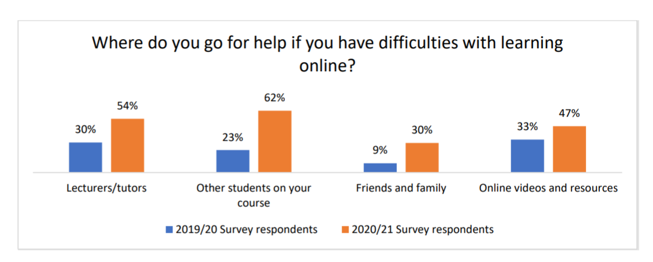
Notes:
As you can see, unsurprisingly, the reliance on all areas of support has increased dramatically. Highlighting the importance of ensuring that support in all areas is covered.
What can we do? - We can make sure that we are consistent with our messaging to students to help ensure they are well supported independent learners.
E.g. Signposting them to the Ed tech guides or reminding them they have access to LinkedIn learning and recommend relevant courses to them
Carolyne will share the links for these for internal staff
The 2020/21 survey expanded this question to drill down further and find out which groups students reached out to most, so although we cannot compare to previous years, we can compare to the benchmark data.
QUESTION on next slide - Which 2 groups do you think had the most notable differences in the percentage of students who asked them for support compared to the benchmark data of students from other UK HE institutions?

Slide 13
Notes:
Poll Title: Do not modify the notes in this section to avoid tampering with the Poll Everywhere activity. More info at polleverywhere.com/support Which 2 groups do you think had the most notable differences in the percentage of students who asked them for support compared to the benchmark data of students from other UK HE institutions? https://www.polleverywhere.com/multiple_choice_polls/5xGnncaDLCKJp7MEV5wQc?flow=Default&onscreen=persist

Slide 14
Notes:
The most notable differences between the responses from City students and the benchmark data for this question is the percentage of City students who ask the ‘Library staff’ or ‘IT/e-learning staff’ for help, which is higher than the respondents at other UK HE institutions, indicating that there is much more pressure and higher expectations from these departments at City.
Library 4% higher
IT/E-learning staff 15%
So, thinking of ways to reduce these numbers is important – for example if all students were given time within their module to work through the Library and IT induction modules on Moodle it could go some way to reduce the numbers.

Slide 15
What one thing should be done to improve the quality of online and digital learning
More interaction with lecturers
Smaller group sizes for online sessions to encourage engagement and participation from students
More interaction in synchronous session with live quizzes
More worked examples and opportunities to discuss coursework with lecturers
More active online learning spaces where students can collaborate and speak to others on their course
Consistent use of Moodle across modules to allow for easier access to resources and links to online classes.
Provide students with individual licences for software needed to complete coursework
Support with wifi costs to allow students to access online services and platforms

Slide 16
What one thing should be done to improve the quality of online and digital learning
More interaction with lecturers
Smaller group sizes for online sessions to encourage engagement and participation from students
More interaction in synchronous session with live quizzes
More worked examples and opportunities to discuss coursework with lecturers
More active online learning spaces where students can collaborate and speak to others on their course
Consistent use of Moodle across modules to allow for easier access to resources and links to online classes.
Provide students with individual licences for software needed to complete coursework
Support with wifi costs to allow students to access online services and platforms
Thoughts from Student Digital Assistants
Notes:
First 4 – Carolyne
Second 4 - Andrei

Slide 17
Recommendations
Communication
Remote learning fund
Online learning
Notes:
Comms - Ed tech guides - https://city-uk-ett.libguides.com/student – IT related comms about data privacy – Library about existing course e.g. plagiarism - More focus groups to get student feedback
Remote learning fund - Increase funding and provide clearer guidance around eligibility – other sources of support such as charities (low cost devices)
Online Learning – Review methods of providing network access (Poss use of students for testing) – Timetabled sessions to focus on digital skills – clear guidance on digital skills required for course - guidance around productivity tools and creating structure
Jisc Digital experience insights survey 2020/21 - https://staffhub.city.ac.uk/_media/intranet-site/documents/learning-enhancement-and-development-lead/2020-21-Student-Digital-Experience-Insights-Survey-report.pdf

Slide 18
Thank you!

