Slide 1
Establishing a Teaching Persona 1: teaching identities
Dr Jessica Hancock and Dr Ruth Windscheffel, LEaD jessica.hancock@city.ac.uk

Slide 2
Today (1/4)
Components of teaching identities
Our chosen identities
Dealing with pressures
The identities of our students

Slide 3
Intros
Research area/ discipline
Teaching experience (if any – fine if you’ve not started yet)

Slide 4
Constructing identities
Role models – copy or avoid?
Personality – other selves
Relational
Process – changeable, adaptable

Slide 5
Role models
Something positive about your experiences of being taught at university
Something that could be improved about your experiences of being taught at university
Pollev.com/LeadJess

Slide 6
The teacher as part of HE in the UK
Contact hours – 16-30% - independent learning
Critical thinking
Blended learning
Learning outcomes – assessment alignment – transparency
Modules/ credits – UG (120), PGT (180)

Slide 7
padlet.com/eteachp/pic

Slide 8
What kind of teacher would you like to be?
Discuss the picture(s) you chose with the rest of your group (1 min each)
Choose a picture to represent a shared desired identity for the whole group, or draw/ find your own. Be prepared to share your screen with the rest of the group after this activity (5 mins)
What might the barriers be to becoming this kind of teacher? How might they be overcome? (if time)

Slide 9
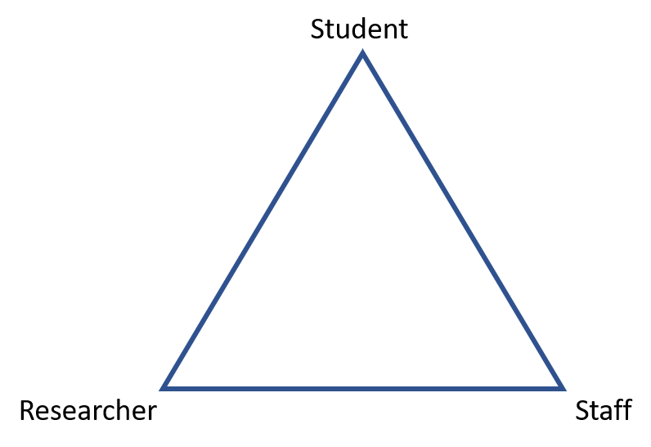
Managing multiple identities
Do you feel like a researcher, a student or a member of staff?
What are the advantages or disadvantages of each?
Pollev.com/LeadJess
Notes:
Ruth lead

Slide 10
https://imgs.xkcd.com/comics/impostor_syndrome.png
Notes:
Ruth lead
Should it be imposter experience – puts emphasis on it being a systemic problem rather than something for individual to fix (cf development of wellbeing agenda to be teaching people to survive in broken system rather than challenging system itself)
Imposter syndrome and PhD –see eg Moore, A. 2018, "“Blackboxing it”: A Poetic Min/d/ing the Gap of an Imposter Experience in Academia", Art/Research International: A Transdisciplinary Journal, vol. 3, no. 1, pp. 30-52.
Knights, D., & Clarke, C. A. (2014). It’s a bittersweet symphony, this life: Fragile academic selves and insecure identities at work. Organization Studies, 35(3), 335-357. doi:10.1177/0170840613508396

Slide 11
Authority
How much?
Respect?
Approachability?
Colleagues?
Dress?
Credentials?
https://blogs.city.ac.uk/phdteach/
Notes:
Ruth lead

Slide 12
The teacher as gatekeeper: hidden curriculums
Information literacy
Academic literacies
Cultural competence
Gender and racial equality
Blame:
student
lecturer
curriculum
Support – learning support, counselling, LEaD academic team

Slide 13
Diversity
Equality
Compassion

Slide 14
Boundaries
Availability
Expertise
Role
www.city.ac.uk/study/student-support

Slide 15
Knowing your students
What do you know about your students?
How will your identity be constructed in relation to your students?
Pollev.com/LeadJess

