Slide 1
Establishing a Teaching Persona 3: engaging students and enabling them to participate in creative learning
Dr Jessica Hancock and Dr Jane Secker, LEaD
jessica.hancock@city.ac.uk

Slide 2
Today
Engaging students with active learning
Managing discussions
Creative learning

Slide 3
Engaging students
What makes you engaged with learning?
What worries you about engaging students when you teach?
Pollev.com/LeadJess

Slide 4
Student engagement
Online – cameras, chat
Active learning
Creative learning
Time for telling
Explain the pedagogy
Ground rules and expectations – discuss
Susan Cain – Quiet / wu wei (purposeful inaction -Charlie Reis)

Slide 5
Discussion 1: Padlet
Why might students be silent if you ask them a question in class?
https://padlet.com/drjess/etp

Slide 6
Discussion 1: Padlet
Benefits
Issues
Useful for you?

Slide 7
Discussion 2: all call
What’s the best kind of question to ask students to generate a response?

Slide 8
Discussion 2: all call
Benefits
Issues
Useful for you?

Slide 9
Discussion 3: pairs
What do you do if one or two students dominate the conversation?
What if students appear to just want you to tell them the answer?

Slide 10
Discussion 3: pairs
Benefits
Issues
Useful for you?

Slide 11
Discussion 4: small group
What happens if you don’t know the answer to a question?
What happens if a student says something offensive?
What if students are talking about something irrelevant?
What if students stop talking?

Slide 12
Discussion 4: groups
Benefits
Issues
Useful for you?

Slide 13
Playful approaches to learning

Slide 14
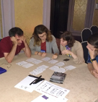
Copyright the card game
https://copyrightliteracy.org/resources/copyright-the-card-game/

Slide 15
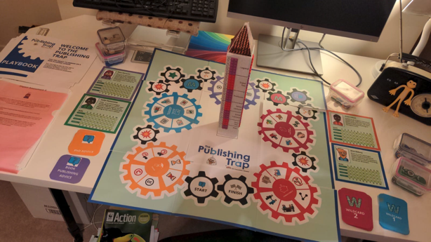
The Publishing Trap
https://copyrightliteracy.org/resources/the-publishing-trap/

Slide 16
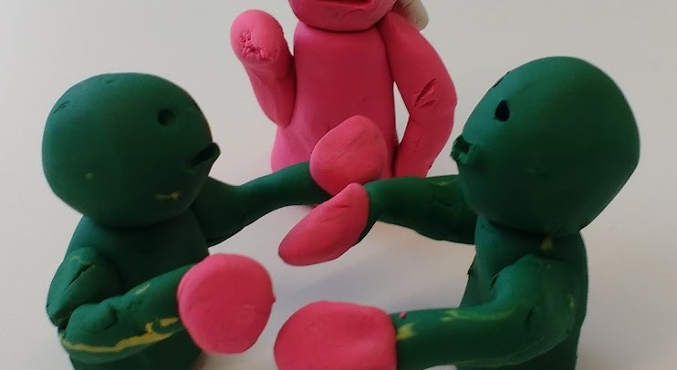
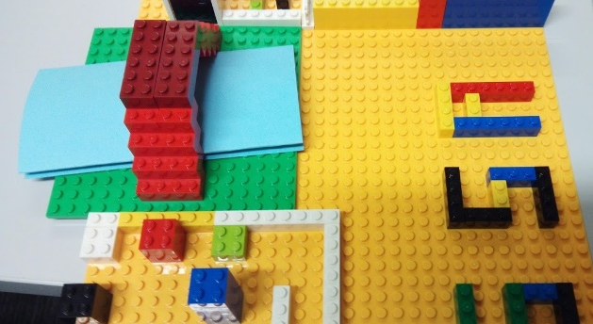
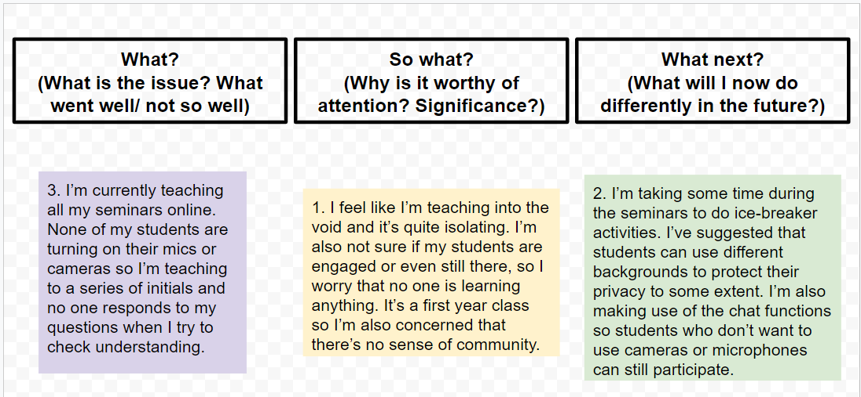

Slide 17
Creative and playful learning
Different ways of looking at things – constructing knowledge
New and exciting or uncomfortable?
Competitiveness – good or bad?
Childish?
Requires particular skills?
Difficult online?

Slide 18
Diversity
Equality
Compassion

Slide 19
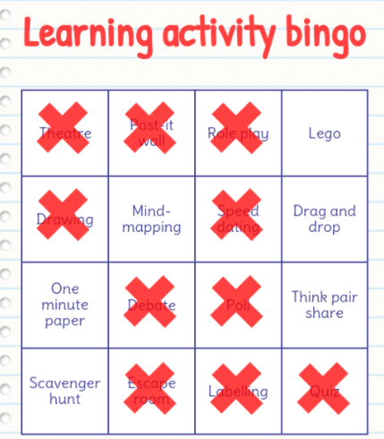
Learning activity bingo:
line across
https://mfbc.us/m/gvnpqg

Slide 20
Learning activity bingo – line across https://mfbc.us/m/gvnpqg
Think pair share
Role play
Quiz
Mind-mapping
One minute paper
Poll
Drawing
Lego
Debate
Post-it wall
Scavenger hunt
Escape room
Drag and drop
Labelling
Theatre
Speed dating
Notes:
https://myfreebingocards.com/bingo-card-generator/free/gvnpqg

Slide 21
Playful learning and you
What opportunities are there for introducing playful learning in your own subject or teaching?
What barriers are there to introducing playful learning in your own subject or teaching?

