Slide 1
Establishing a Teaching Persona 4: reflection and developing your teaching
Dr Jessica Hancock and Prof. Pam Parker, LEaD jessica.hancock@city.ac.uk

Slide 2
Today
Reflecting on teaching
Developing your teaching
Next steps?

Slide 3
Why reflect?

Slide 4
The teacher as reflector
Informal/ formal
Stephen Brookfield’s four lenses: self/ students /colleagues/ theory (LTA)
Peer-supported review of education
Questions to ask:
what went well/ badly?
why was this?
what will I do differently next time?

Slide 5
There’s no single best (or worst) way to reflect (or to teach!)

Slide 6
What? So what? Now what?

Slide 7
A moment for reflection
Think about a time when you found learning difficult
What was difficult?
So what – why did you find it difficult? What was helpful and unhelpful?
Now what – what did you learn from working through the difficulty? What might you do differently next time?
Thinking time – 5 minutes
Sharing time – 10 minutes
Notes:
Suggest turning off camera, moving to somewhere diff?

Slide 8
Reflection doesn’t need to lead to revolution

Slide 9
Developing teaching
How do you get where you want to be?
What are you good at?
What do you want to improve?

Slide 10
Gaye Manwaring: Conjunction Model
WHAT: description, actions, feelings
WHY: analysis
SO: specific plan What will you do next about this specific situation? | ALSO: generalised plan What general things have you learned to transfer to other situations?
BUT: other considerations What will be the implications for you eg training? | BUT: other considerations What will be the implications eg resources?
THEN: policy What changes could you suggest to others?

Slide 11
Diversity
Equality
Compassion

Slide 12
padlet.com/drjess/pic

Slide 13
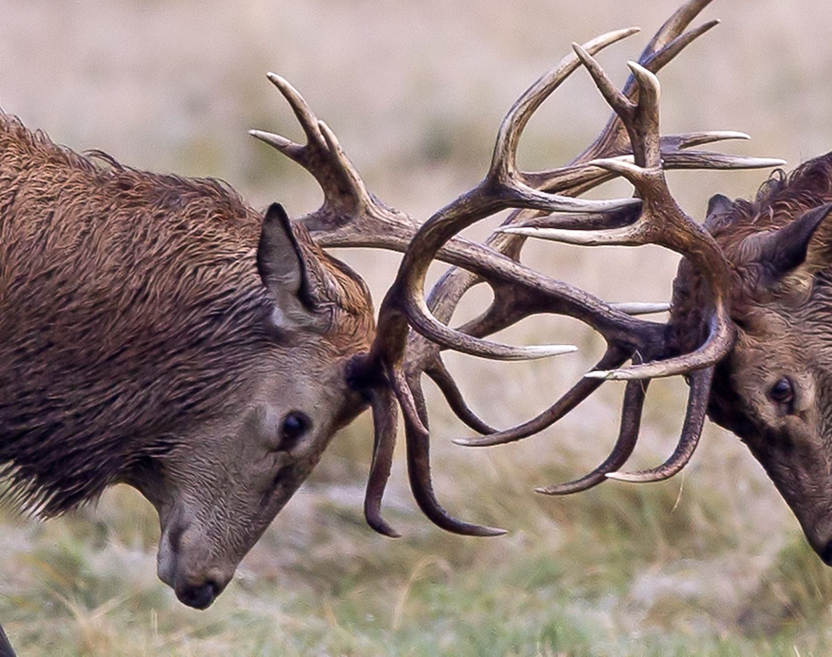
Reasons for self-criticism
to pay attention to issues and so prevent them
to motivate/improve ourselves
to internalise anger/hurt/ self-hatred that we feel unable to express

Slide 14
Common processes
Situation: I am struggling with teaching
Thoughts: Others will think I am incompetent, I am useless (self critic)
Feelings: Upset, anxious, frustrated
Behaviours: avoid
Compassionate response:
It is understandable to feel like this as it is a new skill
Every new teacher is unsure at first
Experienced lecturers do often have these preoccupations
How can I help myself? - talk to others, seek advice, sleep, exercise, practise
Notes:
Find rhythm of ones own soothing breathing
Sit straight – try head down vs head straight ahead
Try hands collapsed by your side …on your knees and then on thighs
Compare smile vs neutral
Compare friendly voice tone to neutral

Slide 15
Category | Thinking habit | E.g.
Negative or extreme thinking | 1. All or nothing thinking | I’m a failure, Everyone hates me
 | 2. Overgeneralisation | One bad class means I’m no good
 | 3. Mental filtering | This week has been terrible
 | 4. Discounting the positives | I only passed because I was lucky
Self critical thinking | 5. Labelling | I’m a loser
 | 6. Demands | I should finish X, Y and Z by tonight
 | 7. Blame/ personalising | It’s my fault I didn’t work hard enough
 | 8. Unrealistic standards/Perfectionism | I have to be the best teacher at City
 | 9. Double standards | It’s ok for other people to make a mistake
Focus on the future | 10. Fortune telling | I’ll fail
 | 11. Catastrophising | I’ll fail and then never get a job
Thinking based on a feeling | 12. Mind reading | She thinks I’m stupid
 | 13. Emotional reasoning | I feel bad, therefore my life’s a disaster
 | 14. Low Frustration Tolerance | I (feel that) can’t cope

Slide 16
What kind of coach do you want to be for yourself?
Coach A:
Aggressive, critical, sets unrealistic targets, criticises you, shouts when you miss
“You missed again, you’re not good enough and will never win!”
Coach B:
Blasé, uninvolved, lets the team decide when to take breaks, and gives no specific tips on how to improve
“It’s up to you lot, just keep going..”
Coach C:
Compassionate, supportive, motivating, gives specific feedback, encouraging whatever the score
“Keep on your toes and try to defend a bit more, you can do it!”
You're fine as you are – but keep the curiosity going

Slide 17
Further resources
MA Academic Practice modules – LTA
City PhD videos
Phil Race In At The Deep End
University of Bath videos
QAA Scotland video
Stanford advice
Blogs:
https://blogs.city.ac.uk/phdteach/
Higher Education Academy / Advance HE
http://blog.highereducationwhisperer.com/
https://teachingandlearninginhighered.org/
https://lmutake5.wordpress.com/
Each other

